Slide 1

TEAM DISPATCH
JOHN EHLINGER • ANNIE DARMOFAL
STEPHANIE CASTILLO • HUGH SATO
Notes:
John - [Introduce the team…] ”Hi I’m John and we are team Dispatch. My team members are “Annie”, “Stephanie”, and “ Hugh” … We are excited to be here today presenting our IDEA HACK working with the Explorer Program!

Slide 2
The Explorer Program Mission:
Explore
Provide students with the opportunity to unlock their creative abilities and express themselves like never before.
Inspire
Empower students to reflect on their work, inspiring change and progress in their own lives.
Transform
Transform students’ lives through basic life lessons to ensure success throughout high school and post high school.
Notes:
John - The Explorer Program has a clear mission and has already accomplished a great deal in a short period of time but as with any “StartUp” its growth will face successes along with challenges that need to be solved … we (look at acknowledge team) are here today to address ...

Slide 3
How do we engage the Explorers through the use of technology?
The Big Question:
Notes:
John - Finding a seamless way to connect groups is a problem all organizations face BUT every situation is unique and in early stages resources can be limited … in the Explorers case: students may have limited access to computers, smart phones and wifi, growing organizations have to budget, in this case we are limited to $500 and as a one year old program experimentation is needed to find the perfect balance - we believe that the following slides are a solution for the Explorer program’s “Big Question”
As Julius said “in order to move mountains, start with the smallest rocks” and we hope this presentation will “Provided a road map” to solve the problem starting with “small actionable steps” ... “Annie” is going to to talk about “Our Solution”

Slide 4
Our solution:
Notes:
Create a portal as a central location for news, announcements, and story sharing accessible by mentors, parents and investors. And then give the explorers the ability to upload photos in real time. How can we do that?

Slide 5

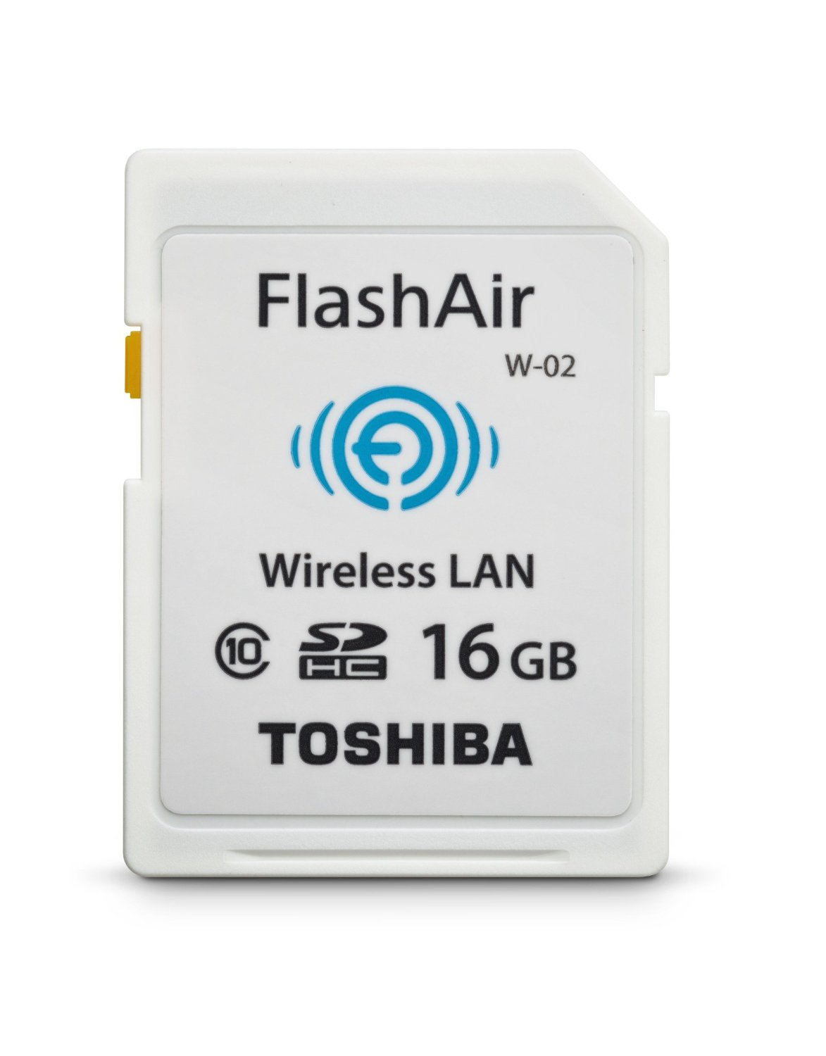
Notes:
Wifi enabled memory cards. These enable students to upload images to the internet without the use of a computer, tablet or smartphone. Works with the camera you already own. Creates its own wifi. and allows for on the spot editing and sharing.

Slide 6
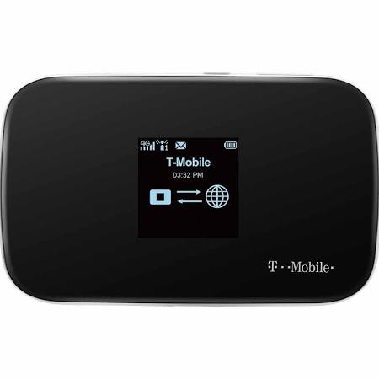
New tools: Mobile Hotspot
Students can alternate taking home the Hotspot so they can upload photos directly from home, so investors, mentors, program staff and other Explorers can stay in contact throughout the week.
Notes:
The second piece of this is purchasing 1 or 2 mobile hotspots to make sure explorers have access to internet.

Slide 7

Notes:
Students with the dispatcher role, which will change week to week, will take home these mobile hotspots for individual use, but also to encourage group meetups within the neighborhood. This role serves as another opportunity for an explorer to act as a leader within their community.

Slide 8
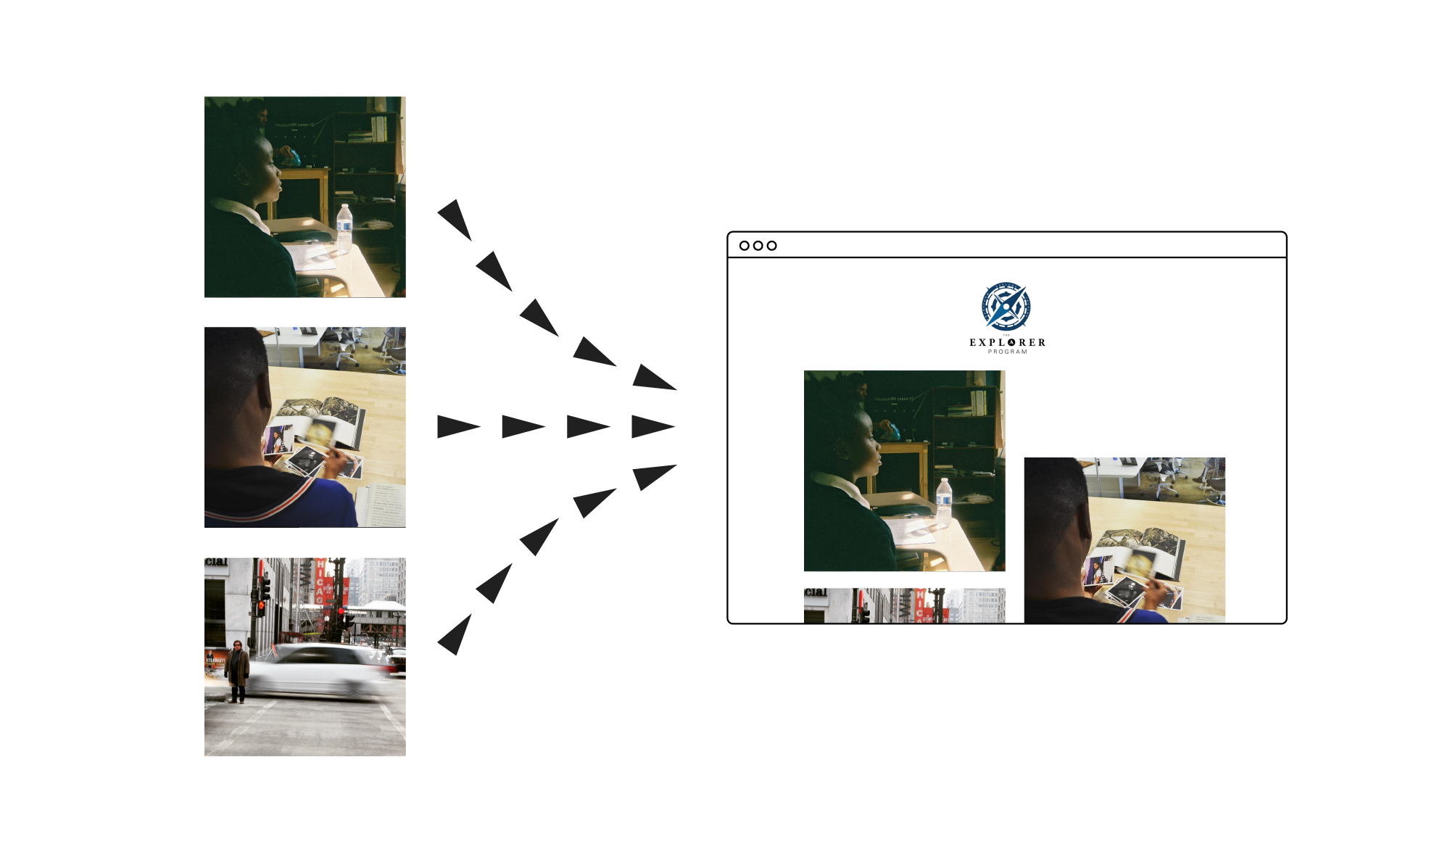
Notes:
Using the hot spot, Images are uploaded to the portal giving others direct and immediate access. Which brings us to our secondary challenge...

Slide 9
How do we get program investors looped into this new communication process?
Notes:
Stephanie
Currently, investors get bi-weekly updates via email. Some read them, others don’t.
And, the Explorer Program does not yet have a coordinated marketing model that will entice investors to want to get involved further outside of capital support.

Slide 10
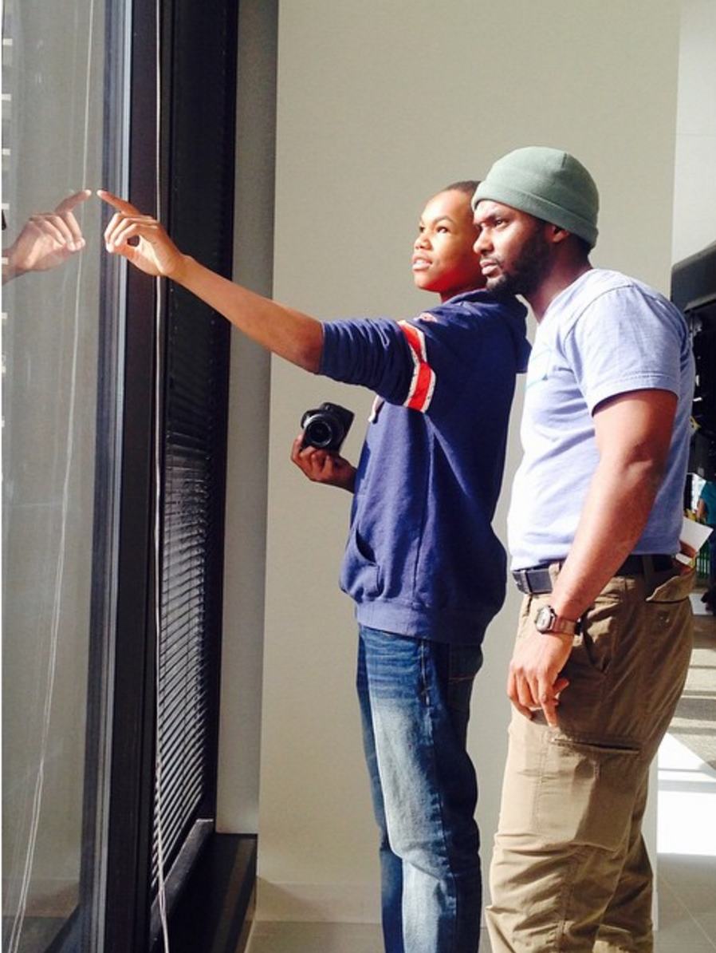
INVESTOR/EXPLORER MENTOR PROGRAM
Investors spending the day with students
Assignments from students to investors
Notes:
Stephanie
For investors, this visit gives them an opportunity to be with and learn from the students. They’ll feel involved and be able to truly feel the one-on-one impact, not just blindly donating from behind a screen
Students giving investors assignments empowers students to take control, give back what they receive, and teach what they have learned.

Slide 11

POSTCARDS
Engages investors and students
Repurposable
Notes:
Stephanie
Students will create postcards from the pictures they took on their mentor visit day with an investor and send it to them.
By sharing their work with their mentor/investors, students will feel empowered and a sense of pride
Investors can put postcards up in their home or office for people to see and also pass along postcards or send them to people they think might be interested in investing/donating

Slide 12


explorers
mentors
DISPATCH
investors
parents
Notes:
Stephanie
How it all comes together:
Ultimately, this comes together to build an ecosystem that connects these different parties,
solves the problem of knowing & understanding what the students are doing outside of the classroom,
and...

Slide 13
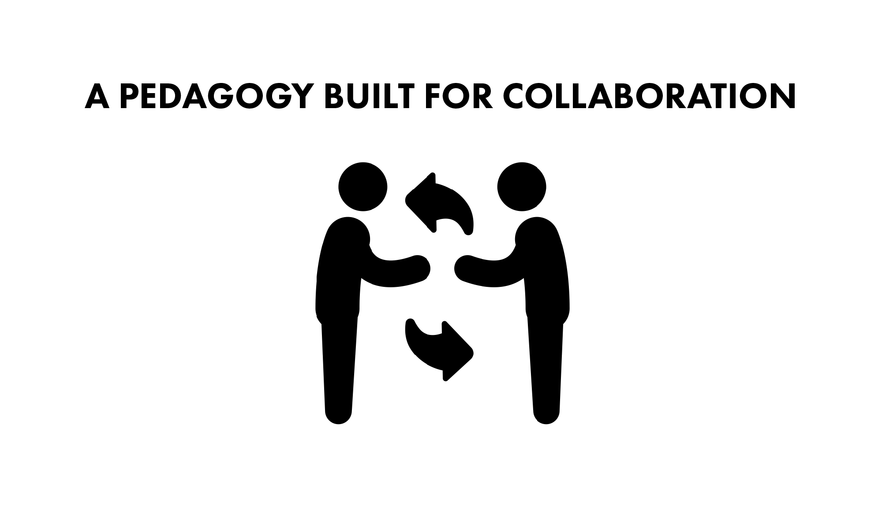
Notes:
and creates a pedagogy built around collaboration.

Slide 14
How much does it all cost?

Slide 15
Costs
T-Mobile Data Plan (5GB/mo) =$40/month x 3 Months = $120
4G Hotspot $35 x 1 = $35
FlashAir Card
$20 x 17 = $340
Total
$495
Notes:
Here we have a table of the hardware and software costs, the largest purchase being the FlashAir, Wifi enabled cards. This does get close to the limit of the proposed budge, but
This cost doesn’t include the various discounts for educators offered by T-Mobile and other carriers.
Link to data plan cost:
http://www.prepaidphonenews.com/2013/01/prepaid-tablet-data-plans-compared.html

Slide 16
How do we make it all happen?

Slide 17

IMPLEMENTATION ROADMAP
Implement Dispatch Portal
Purchase WIFI Memory Cards & Mobile Hotspot
Pair up interested investors with students directly
Schedule visit days
Introduce students & train them on technology.
Implement collaborations and lessons built around our proposed pedagogy.
Notes:
We have identified small, actionable steps that take into account the time needed to build a curriculum based around this technology.

Slide 18

Raspberry Pi, Microcontrollers, and moving forward...
Notes:
Moving forward,
Raspberry Pi, and other microcontrollers in recent years are being introduced into schools, to program to do whatever you want. It can control lights, connect to sensors that are sensitive to light, humidity, and is extremely expandable. In the arts, this means being able to produce interactive installations, which may open up future curriculums for explorers.
I know from my own experience through Gallery37, a similar extracurricular arts program, that these tools increase classroom engagement, opens up the philosophy that we are in control of our digital futures, and fosters proud ownership over the technology and puts control into the explorers hands..
Using Raspberry Pis in a classroom can offer different ways of teaching and learning. It opens up the possibility of seeing computing more as accessible and fun.
We propose using the Rasp Pi to create Wifi Hubs and create resources that allow students to upload images remotely. Moving forward, we believe in empowering the students with the tools to build upon, and introducing explorers to hardware, programming, and the development tools useful in today’s tech career world.
We believe in the integration of the arts into the STEM fields, turning STEM, into STEAM.

Slide 19
Teach what you learn,
Give what you receive.
Notes:
These tools empower students to take leadership and collaboration into their daily lives,
in and out of the classroom.

Slide 20

Thank you!
TEAM DISPATCH
JOHN EHLINGER • ANNIE DARMOFAL
STEPHANIE CASTILLO • HUGH SATO
Notes:
Our solution allows our explorers to collaborate directly with the

